Slide 1
National Info Day Bosnia and Herzegovina– 2nd call for proposals
Banja Luka, 31th March 2017

Slide 2
Danube Transnational Programme

Slide 3
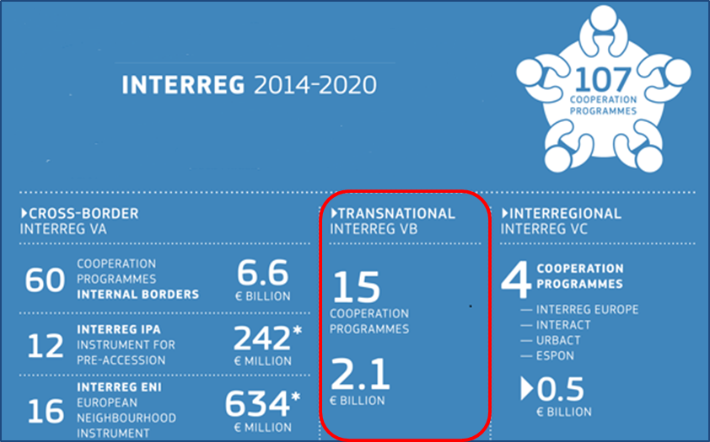
What is DTP?
DTP is a financing instrument
One of the 107 Interreg Programmes 2014-2020
(cross-border, transnational, interregional)

Slide 4
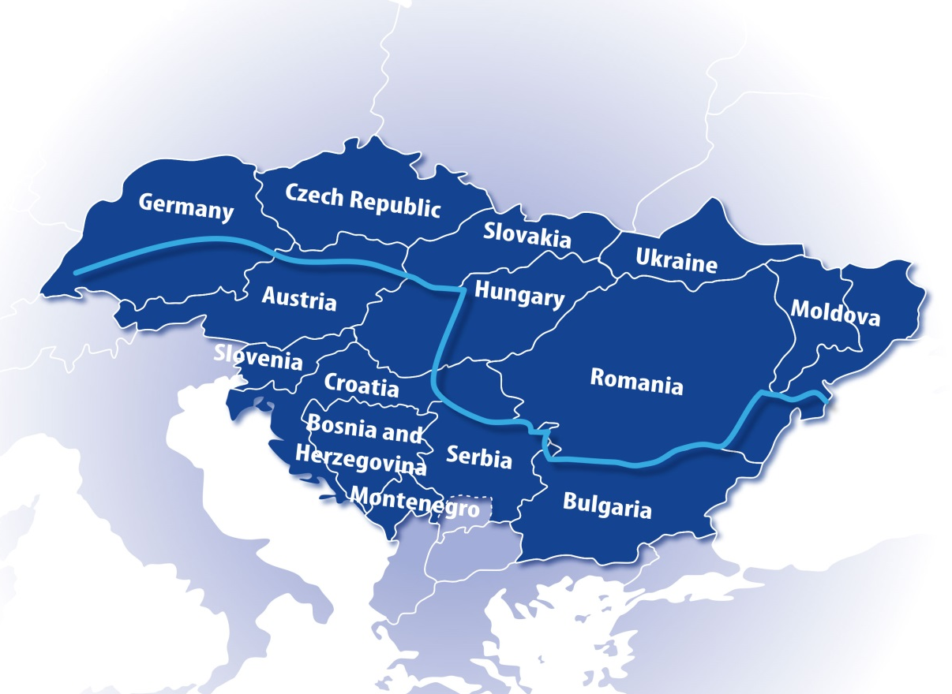
Programme area
14 countries:
9 EU MS: DE, AT, CZ, SI, SK, HU, HR, RO, BG
3 EU (potential) candidate countries: RS, ME, BiH
2 EU neighbourhood countries: UA, MD

Slide 5
What activities do DTP finance?
DTP supports joint cooperation projects which:
- Develop institutional capacity
and ensure knowledge transfer
- Pave the way to new investments
- Support the development of a common framework for policy implementation
in various fields

Slide 6
What activities do DTP finance?
DTP supports joint cooperation projects which:
- Support policy harmonisation
in various fields
- Develop innovative solutions
to common problems

Slide 7
What DTP is NOT!
DTP is NOT:
The Danube Strategy Programme!
EUSDR!
The only financing instrument for EUSDR!
A Programme addressing Danube riparian areas only!
A Programme for big infrastructure!
A research Programme!
A Programme aiming at mere networking!

Slide 8
How DTP is structured?
Innovative and socially responsible Danube Region 1.1: Improve framework conditions for innovation 1.2: Increase competences for business and social innovation
Environment and culture responsible Danube Region 2.1: Strengthen transnational water management and flood risk prevention 2.2: Foster sustainable use of natural and cultural heritage and resources 2.3: Foster the restoration and management of ecological corridors 2.4: Improve preparedness for environmental risk management
Better connected and energy responsible Danube Region
3.1: Support environmentally-friendly and safe transport systems and balanced accessibility of urban and rural areas 3.2: Improve energy security and energy efficiency
Well governed Danube Region 4.1:Improve institutional capacities to tackle major societal challenges 4.2: Support the governance and implementation of the EUSDR

Slide 9
What are the key principles?
Real transnational character
Result-oriented approach
Sustainable development
Durable and transferrable outputs
Integrated territorial approach
Qualitative partnership
Efficiency in terms of mobilised resources

Slide 10
Who can apply?
Public sector
International organisations
Private sector
* LP and IPA PP cannot be profit-making organisations!

Slide 11
Who can apply?
Minimum 3 financing partners from 3 different DTP countries
(LP and at least 2 other PPs)
LP – must come from an EU MS
– cannot be profit-making organisation

Slide 12
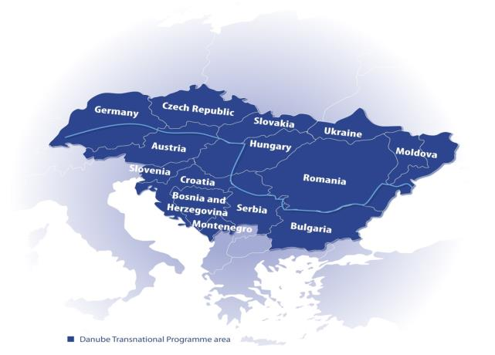
Geographic eligibility
Direct EU financing only for PPs located in Programme area (including MD* & UA*)

Slide 13
Type od Partners
Type of Partner |  | Location | Budget | Budget lines
Directly financed partners | LEAD PARTNER | EU part of the Programme area | Separate | All
 | ERDF PARTNER | EU part of the Programme area | Separate | All
 | IPA PARTNER | Bosnia and Herzegovina, Montenegro, Serbia | Separate | All
 | ENI PARTNER | Moldova and Ukraine | Separate | All
Indirectly financed partners | Associated Strategic Partners (ASPs) | EU countries Non-EU countries of the Programme Area | Part of a "sponsoring" ERDF PARTNER budget | TRAVEL and ACCOMODATION

Slide 14
Funding sources
ERDF
PPs from EU MS
ASPs
IPA
PPs from BA, RS, ME
ENI (conditional)
PPs from MD, UA
ENI
ERDF
IPA

Slide 15
Second Call

Slide 16
When will it be launched?
Estimated launch: May 2017
Submission deadline:
ca. 4 weeks following the launch
Applicants Manual is available
Application Form template is available
Guidelines for the Application Form are available
http://www.interreg-danube.eu/calls/calls-for-proposals/second-call-for-proposals

Slide 17
Which PAs can be addressed?
Innovative and socially responsible Danube Region
Environment and culture responsible Danube Region
Better connected and energy responsible Danube Region

Slide 18
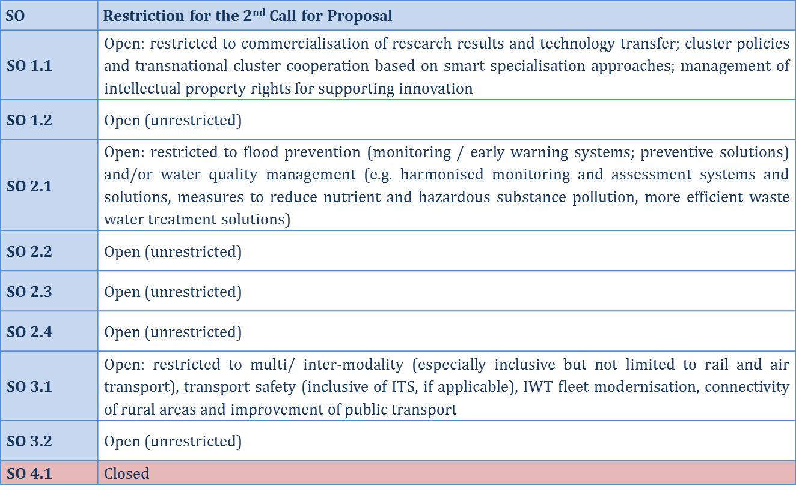
Which SOs can be addressed?

Slide 19
SO 1.1 - Innovation
SO 1.1: Improve framework conditions for innovation
Improve the institutional and infrastructural framework conditions and policy instruments for research & innovation to ensure a broader access to knowledge for the development of new technologies and the social dimension of innovation.

Slide 20
SO 1.1 - Innovation
2nd Call restrictions!!!
Commercialisation of research results and technology transfer; Cluster policies and transnational cluster cooperation based on smart specialisation approaches; Management of intellectual property rights for supporting innovation

Slide 21
SO 1.2 – Business & social innovation
SO 1.2: Increase competences for business and social innovation
Foster innovative learning systems to increase competences of employees in the business sector, to strengthen entrepreneurial culture and learning contributing to better meet social needs and the delivery of services in the general interest.
No restrictions for 2nd Call!

Slide 22
SO 1.2 – Business & social innovation
Topics addressed by the DTP | NOT addressed by the DTP
Projects built around the knowledge triangle of research, education and social innovation, producing knowledge through research, diffusing it through innovative learning systems, and applying it through social innovation in order to: Improve policy learning and development of practical solutions to better adapt human resources to technological change and market requirements Improved policies and practical solutions for entrepreneurial culture and learning Improved environment, skills and competences to advance social innovation and social services to better meet social and address new challenges Building capacities of public administration to better cope with innovation processes | Purely academic, soft research and networking projects not having the key constitutive elements as to allow them to translate soft activities (surveys, studies, analysis, territorial mapping, virtual cooperation, questionnaires, abstract ICT tools etc.) into concrete and sustainable project outputs. Hard infrastructure projects and investment with significant costs. Projects not looking to proposed innovative learning systems or address social innovation and with no policy uptake capacity.

Slide 23
Project Officer PA1 Marius Niculae marius.niculae@interreg-danube.eu +36 1 896 1967
Contact details PA1

Slide 24
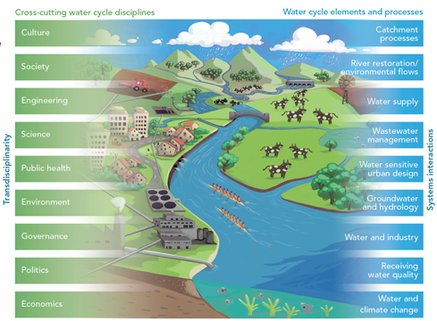
SO 2.1 – Water management
SO 2.1: Strengthen transnational water management and flood risk prevention
Strengthen joint and integrated approaches to further develop and implement River Basin Management Plans in the Partner States in line with the overall Danube River Basin Management Plan in order to improve transnational water management and flood risk prevention contributing to the sustainable provision of ecosystem services.

Slide 25
SO 2.1 – Water management
2nd Call restrictions!!!
Flood prevention (monitoring / early warning systems; preventive solutions) Water quality management (e.g. harmonised monitoring and assessment systems and solutions, measures to reduce nutrient and hazardous substance pollution, more efficient waste water treatment solutions).

Slide 26
SO 2.2 – Natural and cultural heritage
SO 2.2: Foster sustainable use of natural and cultural heritage and resources
Strengthen joint and integrated approaches to preserve and manage the diversity of natural and cultural heritage and resources in the Danube region as a basis for sustainable development and growth strategies.
No restrictions for 2nd Call!

Slide 27
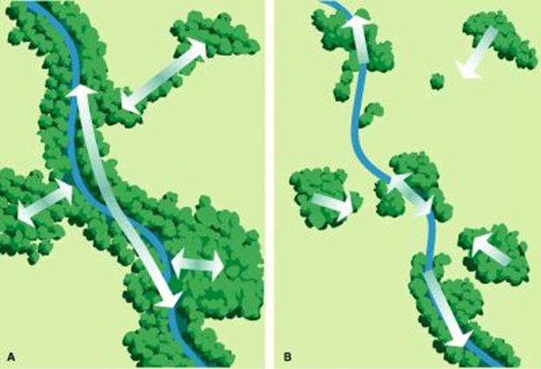
SO 2.3 – Ecological corridors
SO 2.3: Foster the restoration and management of ecological corridors
Strengthen effective approaches to preservation, restoring and management of bio-corridors and wetlands of transnational relevance to contribute to the better conservation status of ecosystems of European relevance.
No restrictions for 2nd Call!

Slide 28
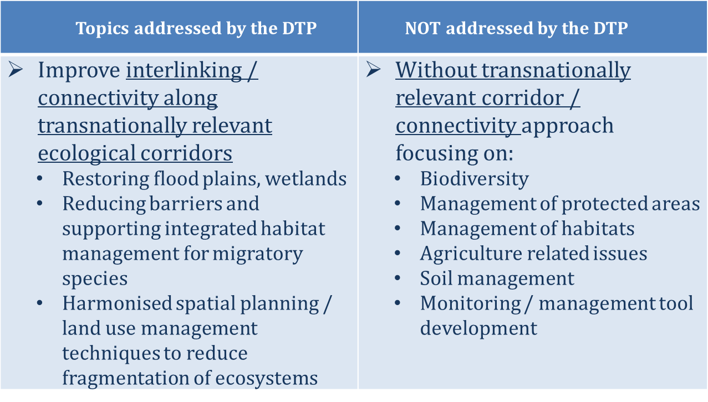
SO 2.3 – Ecological corridors

Slide 29
SO 2.4 – Environmental risk management
SO 2.4: Improve preparedness for environmental risk management
Establish and develop a more effective governance system for environmental protection addressing emergency situations and improve the preparedness of public authorities and civil protection organisation contributing to the reduction of risks and impact on ecosystem services, biodiversity and human health.
No restrictions for 2nd Call!

Slide 30
SO 2.4 – Environmental risk management
Topics addressed by the DTP | NOT addressed by the DTP
Strategic, operational cooperation; interoperability among emergency response authorities and stakeholders responding to major transnational emergencies Flood protection, but not directly flood prevention (SO 2.1) Drought management Industrial accidents Single / multi-risks | Flood prevention focus by SO 2.1 Climate change adaptation Air pollution focus Natural disasters not connected to non-functioning ecosystems / man-made actions (earthquakes, geomagnetic storms…) Human health related interventions (e.g. epidemics, diseases)

Slide 31
Project Officers PA2 Simona Ene (SO 2.2) simona.ene@interreg-danube.eu +36 1 795 4082 Gusztav Csomor (SO 2.1, 2.3, 2.4) gusztav.csomor@interreg-danube.eu +36 1 795 3836
Contact details PA2

Slide 32
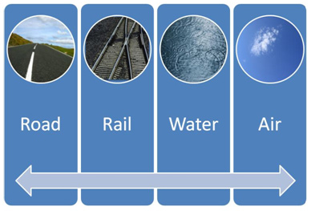
SO 3.1 - Transport
SO 3.1: Support environmentally-friendly and safe transport systems and balanced accessibility of urban and rural areas
Improve planning, coordination and creating practical solutions for an environmentally-friendly, low-carbon and safer transport network and services in the programme area contributing to a balanced accessibility of urban and rural areas.

Slide 33
SO 3.1 - Transport
2nd Call restrictions!!!
Multi/ inter-modality (especially inclusive but not limited to rail and air transport) Transport safety (inclusive of ITS, if applicable) IWT fleet modernisation Connectivity of rural areas Improvement of public transport

Slide 34
SO 3.2 - Energy
So 3.2 Improve energy security and energy efficiency
Contribute to the energy security and energy efficiency of the region BY supporting the development of joint regional storage and distribution solutions and strategies for increasing energy efficiency and renewable energy usage.
No restrictions for 2nd Call!

Slide 35
SO 3.2 - Energy
Topics addressed by the DTP | Topics NOT addressed by the DTP
SO covers a niche area related to smart energy distribution, storage and transmission systems and distributed generation from renewable sources: Development of smart grids and integration of RES Regional energy planning and distribution Security of energy supply through a better exploitation of RES | Development of specific installations, prototypes or technologies Implementation of actions solely aiming the alignment to specific standards, directives or local commitments Indirect approaches (energy efficiency through awareness raising actions/ training of energy managers) The shift towards low-carbon economy - ERDF Regulation 1301/2013, Art.5, (4)

Slide 36
Project Officer PA3 Ana Leganel ana.leganel@interreg-danube.eu +36 1 795 5338
Contact details PA3

Slide 37
How long can a project be?
Maximum duration of projects:
36 months

Slide 38
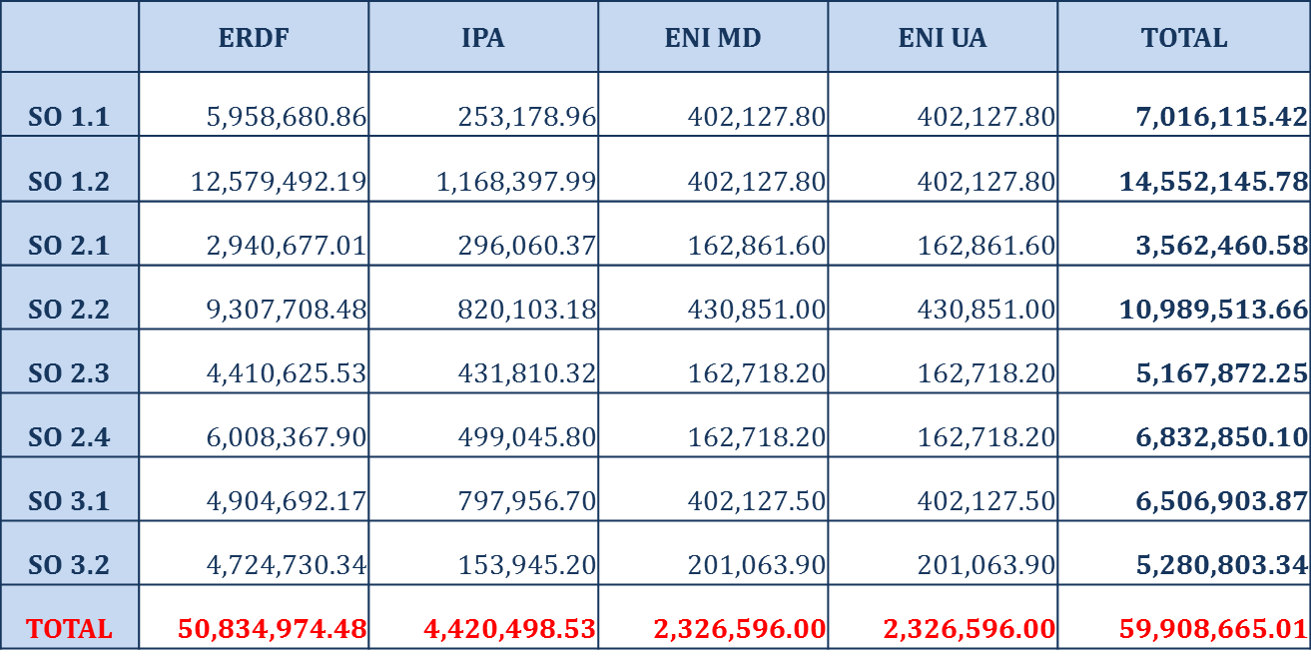
How much money do I have?
Budget of the 2nd Call for Proposals in EUR
Planned to be available at the launch of the call!

Slide 39
How to develop a successful project?

Slide 40
Start with…
… the project idea…
Look for the most appropriate partners…
Develop the intervention logic…
Develop the workplan…
Create synergies and capitalise…

Slide 41
Intervention Logic
DTP core principle → result-orientation, the basis is the change
Intervention logic → tool showing how the change is to be achieved
built upon:
Status quo
The change
The specific objectives
The actions, outputs, stakeholders and target groups
The results and durability
IF
right activities are implemented & appropriate outputs are delivered, THEN
planned objectives are reached & envisaged result is produced.

Slide 42
Intervention logic
TERMINOLOGY | DEFINITION
main objective | Describes the strategic and long term change that the project seeks to achieve for the benefit of the target groups.
specific objective | Describes the specific and immediate effects of the project and it can be realistically achieved within the implementation period.
result | Constitutes the immediate advantage of carrying out the project, telling us about the benefit of using the project main outputs. It should indicate the change the project is aiming for.
output | It tells us what has actually been produced for the money given to the project. It can be captured by a programme output indicator, and directly contributes to the achievement of the project results. E.g.: transnational strategy
deliverable | Is a side-product or service of the project that contributes to the development of a project’s main output. E.g.: country analysis of the status quo in a certain filed (side product that is contributing to the strategy mentioned above)

Slide 43
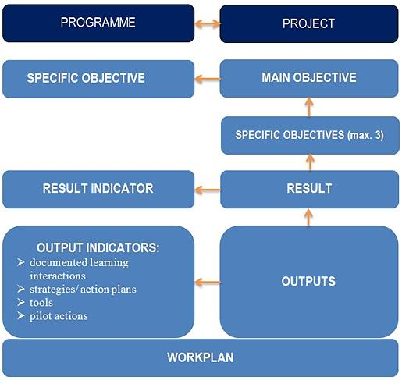
Intervention Logic

Slide 44
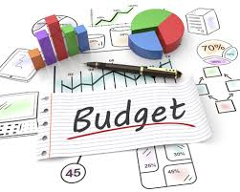
Project budget planning
Application Form
Requested project budget, work packages and activities
Investment and equipment
Application Form - financial Part (excel tables)
Complete financial information
Implementation Manual (and Control Guidelines)
Eligibility of expenditure

Slide 45
Project budget planning
Sources of funding:
85% EU contribution ensured by DTP (ERDF, IPA, ENI)
State contribution - – check the website!
Public contribution (national level information, NCP support)
Private contribution

Slide 46
Project budget planning
Work packages and budget lines from PP level:
Build up the partners’ budgets on the basis of their activities per work packages by defining the costs per budget lines for each WP
The budgets of the project partners will produce the total budget overview for partners per budget lines and per work packages

Slide 47
Project budget planning
Spending forecast of the project
Planning the project budget per reporting period
Spending forecasts given at partner level will “produce” the project spending forecast
Periods have to cover 6 months, starting from the month of the approval date of the project

Slide 48
Project budget planning
Spending forecast of the project
To be planned carefully by each project partner:
The spending level per partner influences the overall project level spending
Should be in line with the time plan of the project
Activities fulfilled within the reporting period, i.e. expenditure incurred, expenditure paid within the reporting period, validated expenditure of the reporting period
Should be realistic
Consider the timeframe for each activity, including also the time needed for public procurements and payments!

Slide 49
Project budget planning
Use of the EURO
Project budget (and partner budget) to be planned in Euro
All expenditure to be reported in Euro
EU contribution will be transferred to LP in Euro
Expenditure incurred by project partners in a currency other than the euro shall be converted into euro by using the monthly accounting exchange rate of the European Commission in the month during which expenditure was submitted for verification to the controller (http://ec.europa.eu/budget/contracts_grants/info_contracts/inforeuro/inforeuro_en.cfm)

Slide 50
Eligibility of expenditure

Slide 51
Eligibility of expenditure
Hierarchy of rules
General eligibility rules
Eligibility of expenditure by budget lines
Special eligibility rules

Slide 52
Eligibility of expenditure
Hierarchy of rules
EU Regulations
Programme rules
National (including specific institutional) rules
The eligibility rules laid down in the programme level documents cannot be overruled by national or institutional legislation.

Slide 53
Eligibility of expenditure
General eligibility rules

Slide 54
General eligibility rules
All expenditures:
Are related to the initiation and implementation of the project
Comply with the principle of real costs, with the exception of the costs calculated as flat rates and lump sums
Are incurred and paid by the project partner indicated in the application form during the eligibility period of the project
Comply with the principle of efficiency, effectiveness and economy

Slide 55
General eligibility rules
All expenditures:
Relate to activities that have not been financed from other financial instruments
Are supported by invoices or other documents with probative value directly attributable to a certain project partner with the exception of the costs calculated as flat rates and lump sums
Are in line with eligibility rules on EU, programme and national level

Slide 56
Eligibility of expenditure
Second hand equipment Not exhaustive list
Contributions in kind
Value added tax except where it is non-recoverable
Purchase of land and existing buildings
Interest on debt
Costs related to fluctuation of foreign exchange rate
Costs of gifts, except those not exceeding 50 EUR per gift where related to promotion, communication, publicity or information
Common costs
Fines, financial penalties and expenditure on legal disputes and litigation
Ineligible expenditures

Slide 57
Eligibility in time
Eligibility in time
Eligible project expenditure shall be incurred and paid within the project period defined by the starting date and end date of the project according to the approved Application Form.
Exceptions
• Preparation costs
• Control costs related to the last progress report and application for reimbursement
• Expenditure incurred in the last reporting period

Slide 58
Eligibility of expenditure
Eligibility of expenditure by budget lines

Slide 59
Eligibility of expenditure
by budget lines
1.Staff cost
Real cost
Flat rate (up to 20% of the direct cost)
2.Office and admin.
4.External expertise & service
5.Equipment
6.Infrastructure & works
Flatrate (15% of staff cost)
3.Travel & accommodation

Slide 60
Eligibility of expenditure
Staff costs
The costs of the personnel employed by the beneficiary institution and executing tasks for the project
Limited to:
• Salary payments
• Any other costs directly linked to salary payments incurred and paid by the employer, such as employment taxes and social security

Slide 61
Eligibility of expenditure
by budget lines
Methods of reimbursement:
Real cost basis
As a flat rate up to 20% of direct costs other than staff costs
Each Project partner must choose one reimbursement option in the Application Form which will remain unchanged through the entire project period.

Slide 62
Eligibility of expenditure
by budget lines
Real cost method:
Justification and supporting documents necessary
Full-time working on the project
(no timesheet necessary)
Part-time work on the project
Part-time with a fixed percentage of time worked per month on the operation (no timesheets)
Part-time with a flexible number of hours worked per month (timesheet necessary)
On an hourly basis (timesheet necessary)

Slide 63
Eligibility of expenditure
by budget lines
Flat rate method:
No justification and supporting documents is needed
Flat rate defined in approved AF shall be automatically applied by the given project partner for reporting staff costs in each WP (except WP0) and each reporting period
Cannot exceed flat rate defined in approved AF
No further staff costs incurred on real costs basis can be reported
Eligibility of staff costs does not depend on the form of reimbursement

Slide 64
Eligibility of expenditure
by budget lines
Basis of calculation of the BL1-Staff costs
Eligible BL1 Staff costs = Total direct costs x flat rate
Eligible staff costs (BL1 WP1) = 7000 x 20% = 1400
Direct costs | WP1
BL3 Travel an accommodation costs | 1000
BL4 External expertise and service costs | 2000
BL5 Equipment expenditure | 3000
BL6 Infrastructure and works | 1000
Total direct costs (BL3+BL4+BL5+BL6) | 7000

Slide 65
Eligibility of expenditure
by budget lines
Office and administration expenditure
Flat rate basis of 15% of the eligible staff costs of the project
Cannot be claimed as direct cost under other budget lines
If the staff costs are not eligible, office and administration costs cannot be declared
If the staff costs are declared on flat rate basis, office and administration are eligible
No staff costs declared in relevant WP, no Office and administration expenditure can be declared

Slide 66
Eligibility of expenditure
by budget lines
The following types of expenditures are included under this budget line (exhaustive list):
Office rent
Insurance and taxes related to the buildings where the staff is located and to the equipment of the office (e.g. fire, theft insurances)
Utilities (e.g. electricity, heating, water)
Office supplies
General accounting provided inside the beneficiary organisation
Archives
Maintenance, cleaning and repairs
Security
IT systems
Communication (e.g. telephone, fax, internet, postal services, business cards)
Bank charges for opening and administering the account or accounts where the implementation of an operation requires a separate account to be opened
Charges for transnational financial transactions

Slide 67
Eligibility of expenditure
by budget lines
Travel and accommodation costs
Option A)
Travel costs
Costs of meals
Accommodation costs
Visa costs
Daily allowances

Slide 68
Eligibility of expenditure
by budget lines
Travel and accommodation costs
Option B)
Per diems according to the EC-funded external aid contracts
Accommodation
Meals
Local travel within the place of mission and sundry expenses
The current per diem rates can be found on the EC website: https://ec.europa.eu/europeaid/sites/devco/files/perdiem-2015-03-corr-columbia_en.pdf

Slide 69
Eligibility of expenditure
by budget lines
External expertise and service costs
Studies or surveys (e.g. evaluations, strategies, concept notes, design plans, handbooks)
Translations
IT systems and website, modifications and updates
Promotion, communication, publicity or information linked to the project
Financial management
Services related to the organisation and implementation of events or meetings (including rent, catering or interpretation)
Participation in events (e.g. registration fees)
Legal consultancy and notarial services, technical and financial expertise, other consultancy and accountancy services
Training

Slide 70
Eligibility of expenditure
by budget lines
External expertise and service costs
Intellectual property rights
Verifications: Externalised control activities (FLC) for the verification of the project expenditure where it is relevant for the control system of the concerned Partner State
The provision of guarantees by a bank or other financial institution where required by Union or national law or in a programming document adopted by the monitoring committee
Travel and accommodation for external experts, speakers, chairpersons of meetings and service providers
Other specific expertise and services needed for the given project

Slide 71
Eligibility of expenditure
by budget lines
Equipment expenditure
a. Office equipment
b. IT hardware and software
c. Furniture and fittings
d. Laboratory equipment
e. Machines and instruments
f. Tools or devices
g. Vehicles
h. Other specific equipment
Only equipment listed in the approved AF are eligible
Full costs of the equipment should be allocated to the project, if in line with national and institutional regulations
If not, only depreciation costs shall be allocated to the project.
Rental or leasing costs for a certain period during the project lifetime are eligible

Slide 72
Eligibility of expenditure
by budget lines
Infrastructure and works
Only small scale infrastructure is eligible; the transnational character of the investment has to be demonstrated; the activity is approved in the Application Form
This budget line should include execution or both design and execution of works as well as site preparation, delivery, handling installation, renovation

Slide 73
Eligibility of expenditure
Special eligibility rules

Slide 74
Special eligibility rules
Preparation costs
Lump sum of 17,500.00 EUR per project. ERDF contribution part of this amount will be reimbursed to the Lead Partner
Only if the approved project have not received other EU financial support for the project preparation
Covers costs of preparation of the Application and further costs of condition clearing until the contracting the project

Slide 75
Special eligibility rules
Expenditure of the Associated Strategic Partners
EU partners and non-EU partners from eligible area
Added value for the project is demonstrated
ASP-indirectly financed-no separate budget
IPA PP cannot be ”sponsoring” PP
Costs of ASP shall be planned in the ”sponsoring” ERDF PP and shall be paid by the ”sponsoring” ERDF PP
Only travel and accommodation costs of the ASP are eligible under BL3-Travel and accommodation

Slide 76
How is JS assessing the projects?

Slide 77
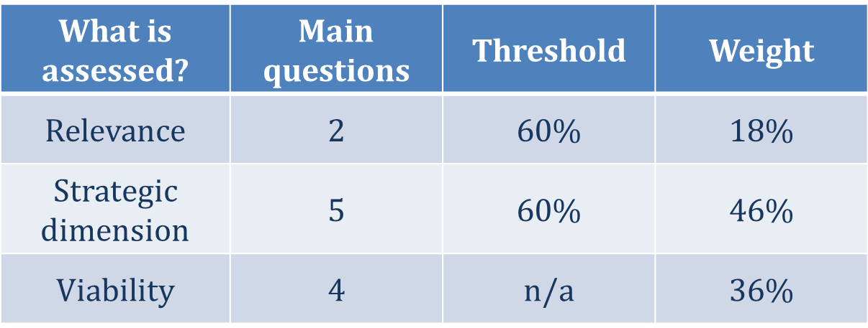
What is the procedure?
Eligibility check
Eligibility of the proposal - 9 Yes/No questions
Eligibility of the partners - 3 Yes/No questions
Quality check

Slide 78
Eligibility assessment-proposal
1. The AF in all its parts has been submitted within the set deadline | Deadline (date and time) to be provided in the Call Announcement.
2. The AF in all its parts has been submitted in the official templates and through the DTP website | Official templates to be published by DTP on the website/ All AF parts to be submitted through DTP website.
3. The AF in all its parts, including the annexes have been submitted in one single package | Application Form pdf xls Annexes Partnership Agreement Co-financing declaration State aid declaration ASP declaration, if relevant International organisation declaration, if relevant are to be submitted in one single package (e.g. zip file)

Slide 79
Eligibility assessment-proposal
4. The AF is compiled in English | AF is to be compiled in EN.
5. Partnership is composed by at least three financing partners from at least three participating countries of which at least one (LP) is located in a Member State | Financing Partners – ERDF, IPA, ENI PPs LA – ERDF PP.
6. Lead Applicant is an eligible beneficiary | LA fulfills the eligibility criteria.
7. At least 3 joint cooperation levels are indicated | According to Art 12(4) of EU reg. 1299/2013: Joint development Joint implementation Joint staffing Joint financing

Slide 80
Eligibility assessment-proposal
8. The proposal contributes to at least two programme output indicators | The proposal contributes to the mandatory output indicator (documented learning interaction) and at least another one.
9. Completeness of Partnership Agreement | PA is signed by all directly financed partners.
Failure to meet any of the above criteria leads to the rejection of the whole project proposal!

Slide 81
Eligibility assessment-partners
1. Financed partners (ERDF/IPA/ENI) are eligible | ERDF, IPA, ENI PPs fulfil the requirements of Applicants Manual Part 2 section II
2. Completeness of submitted ERDF/IPA/ENI partner documents | For each ERDF (incl. LA), IPA and ENI PP there should be enclosed a duly filled in and signed copy of: Declaration of co-financing State Aid declaration Declaration of International Organisations (if relevant)
3. Completeness of submitted ASP documents | For each ASP there should be enclosed a duly filled in and signed copy of ASP declaration
Failure to meet any of the above criteria by one PP leads to the rejection of the respective PP!

Slide 82
Eligibility assessment
BUT
A 5-day healing period is granted to submit missing documents (i.e. Annexes) and meet the eligibility criteria!

Slide 83
Quality assessment-relevance
1. Is the project relevant for the Programme?
Project topic - in line with the SO and Call provisions
Project - is NOT investment or research oriented and it does not target mere networking
Project - is NOT a duplication of previously funded actions
Project intervention logic - coherent with the Programme intervention logic

Slide 84
Quality assessment-relevance
2. Is the need for transnational cooperation demonstrated?
Project transnational dimension and impact - demonstrated through geographical coverage and planned activities
Added value of the transnational cooperation - clearly demonstrated in comparison to a national/ cross-border approach

Slide 85
Quality assessment-strategic
1. Are the territorial needs and challenges identified and duly justified?
Needs and challenges - coherently and comprehensively described
Clear link between planned activities and described needs/ challenges
Needs and challenges - consistent with the programme objectives
Capitalisation of previous results and synergies

Slide 86
Quality assessment-strategic
2. Is the project intervention logic coherent?
IL elements - clearly defined and interlinked
IF
right activities are implemented & appropriate outputs are delivered, THEN
planned objectives are reached & envisaged result is produced.

Slide 87
Quality assessment-strategic
Project main objective is in line with the selected programme SO, clearly defined and supported by appropriate activities
Project specific objectives contribute to the achievement of the main objective and they are linked to the project outputs
Project main result captures the advantage of carrying out the project. There is a clear link between the activities and the result; appropriate partners are involved in the different WPs proving that the planned result can actually be reached
Proposed outputs are achievable within the project lifetime and as a result of the proposed activities; there is a clear connection between the outputs and the needs of the target group

Slide 88
Quality assessment-strategic
3. To what extent does the proposal contribute to an EU strategy or policy?
Relevant strategies/ policies - identified; project contribution thereto - comprehensively explained
Relevant EUSDR PA(s), targets - identified; project contribution thereto - comprehensively explained
EUSDR is embedded in the proposal
(e.g. involvement of EUSDR bodies,
ensure uptake of results by EUSDR)

Slide 89
Quality assessment-strategic
4. Is the partnership composition relevant, justified and balanced for the proposed project?
Geographical coverage - consistent with the territorial needs
PPs - competent to implement planned activities and produce envisaged outputs
All relevant sectors and levels of governance are present
Partnership is balanced
Harmonized benefits for all countries
Equitable distribution of tasks; PP involvement - concordant with the project activities

Slide 90
Quality assessment-strategic
5. Is the target group defined and has ownership of the project results?
Relevant target groups - clearly identified and listed
Integration and use of project outputs
Concrete measures to ensure durability and transferability of project outputs
Contribution to the horizontal principles - coherent with the overall territorial needs and with the programme and project objectives

Slide 91
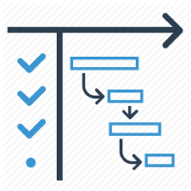
Quality assessment-operational
1. Is the work plan realistic, consistent and coherent?
Timetable – realistic and coherent
Clear link between the activities/ outputs and methodology
Activities and outputs – achievable
Activities - comprehensively and clearly described
Work plan – clear
Project - ready to start the implementation

Slide 92
Quality assessment-operational
2. To what extent are management structures and procedures in line with the project size, duration and needs?
Clear governance of the project
Effective know-how transfer inside the partnership
Quality management structure and adequate procedures
LA - experience in implementing/ coordinating EU projects (esp. ETC) and institutional capacity to manage the project

Slide 93
Quality assessment-operational
3. To what extent are communication activities appropriate and forceful to reach the relevant target groups and stakeholders?
Communication objectives - coherent with the project specific objectives
Adequate methods, means and channels to reach the target groups
Communication activities - consistent with the project deliverables and the specificities of the addressed target group

Slide 94
Quality assessment-operational
4. Does the project budget demonstrate value for money?
Activity/ WP/ BL budget - consistent with the planned actions, involved PPs and duration of activity
Spending forecast - coherent with the sequence of activities/ duration
WP1 & WP2 budget - justified by the planned activities and involved PPs
EE and equipment budget - justified and
realistic for planned activities

Slide 95
To remember!
What to consider when applying?
Coherence of the intervention logic
Project contribution to EUSDR
Transnational dimension and territorial relevance
Durability and transferability of outputs
Composition of the partnership

Slide 96
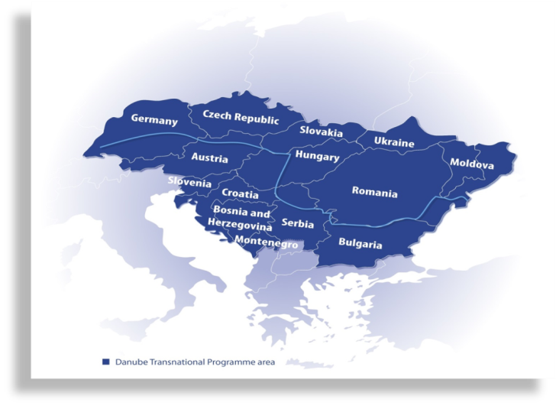
Need help?
http://www.interreg-danube.eu/contacts/national-coordination-and-contact-points

Slide 97
… and if you are successful

Slide 98
You have to…
… work and report activities
… spend and report costs
… ensure the quality of the outputs
… be available for controls and audits

Slide 99
Contact us!
Danube Transnational Programme
Postal address:
Ministry for National Economy
Danube Transnational Programme Managing Authority | Joint Secretariat
József Nádor Tér 2-4, 1051 Budapest, Hungary
Office address:
Danube Transnational Programme Managing Authority | Joint Secretariat
Honvéd utca 13-15, 1055 Budapest, Hungary
danube@interreg-danube.eu
www.interreg-danube.eu

Slide 100
Are there any national rules?

Slide 101
xxx
XXXXX
XXXX

